Slide 1

CUK CONVERTER
Submitted by:
Muhafiz Bilal Khan (244102111)
Pramod Vipparthi (244102112)
Under the guidance of
Dr. Shabari Nath

Slide 2
Introduction
A CUK converter is a type of DC-DC converter that is often used for power management in electronics. The converter uses two inductors and a single capacitor as energy storage elements to transfer energy from input side to output side. It also uses another capacitor for decreasing the ripple in the output voltage.
It combines the features of buck and boost converters allowing for voltage step-up and step-down. It is widely used in renewable energy applications where voltage regulation is essential.

Slide 3
Circuit Diagram of CUK Converter

Slide 4
Operation of CUK Converter
Circuit when switch is on
Circuit when switch is off

Slide 5

Operation in CCM
During CCM, the current through the inductors does not go to zero at the end of each switching cycle. The following equations were obtained when analyzing the operation of CUK converter in CCM.
$$\frac{V_{o}}{V_{dc}}=\frac{D}{1−D}$$
Vo will have the voltage polarity opposite to that of input voltage.
$$I_{L1}=\frac{V_{o}}{R}\left(\frac{D}{1−D}\right)=I_{in}$$
$$I_{L2}=\frac{V_{o}}{R}=I_{o}$$

Slide 6

Operation in CCM
$$∆i_{L1}=\frac{\left(1−D\right)V_{o}T_{s}}{L_{1}}$$
$$∆i_{L2}=\frac{\left(1−D\right)V_{o}T_{s}}{L_{2}}$$
$$∆V_{o}=\frac{D^{2}T_{S}V_{O}}{2C_{1}R}$$
$$∆V_{o}=\frac{\left(1−D\right)T_{S}^{2}V_{O}}{8L_{2}C_{2}}$$

Slide 7
Waveforms in CCM

Slide 8
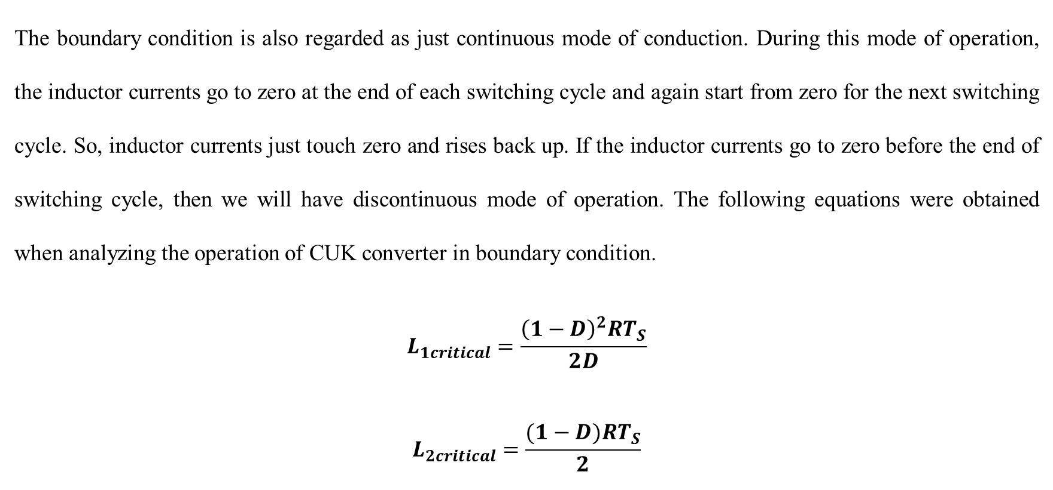
Operation in Boundary Condition
The boundary condition is also regarded as just continuous mode of conduction. During this mode of operation, the inductor currents go to zero at the end of each switching cycle and again start from zero for the next switching cycle. So, inductor currents just touch zero and rises back up. If the inductor currents go to zero before the end of switching cycle, then we will have discontinuous mode of operation. The following equations were obtained when analyzing the operation of CUK converter in boundary condition.
$$L_{1critical}=\frac{{\left(1−D\right)}^{2}RT_{S}}{2D}$$
$$L_{2critical}=\frac{(1−D)RT_{S}}{2}$$

Slide 9
Simulation Parameters
Parameter | Value
Input Voltage | 24 V
Output Voltage | 12 V
Power Rating | 28.8 W
Switching Frequency | 100 kHz

Slide 10
Assumptions
Parameter | Assumed Value
Ripple in current through L₁ | 10% of I_{L1}
Ripple in current through L₂ | 10% of I_{L2}
Ripple in output voltage | 0.1% of V_{o}

Slide 11
Calculated Values
Parameter | Value
D | 0.333
R | 5 Ω
T_{s} | 10⁻⁵ sec
L1 | 0.667 mH
L2 | 0.333 mH
C1 | 0.111 mF
C2 | 25 µF

Slide 12
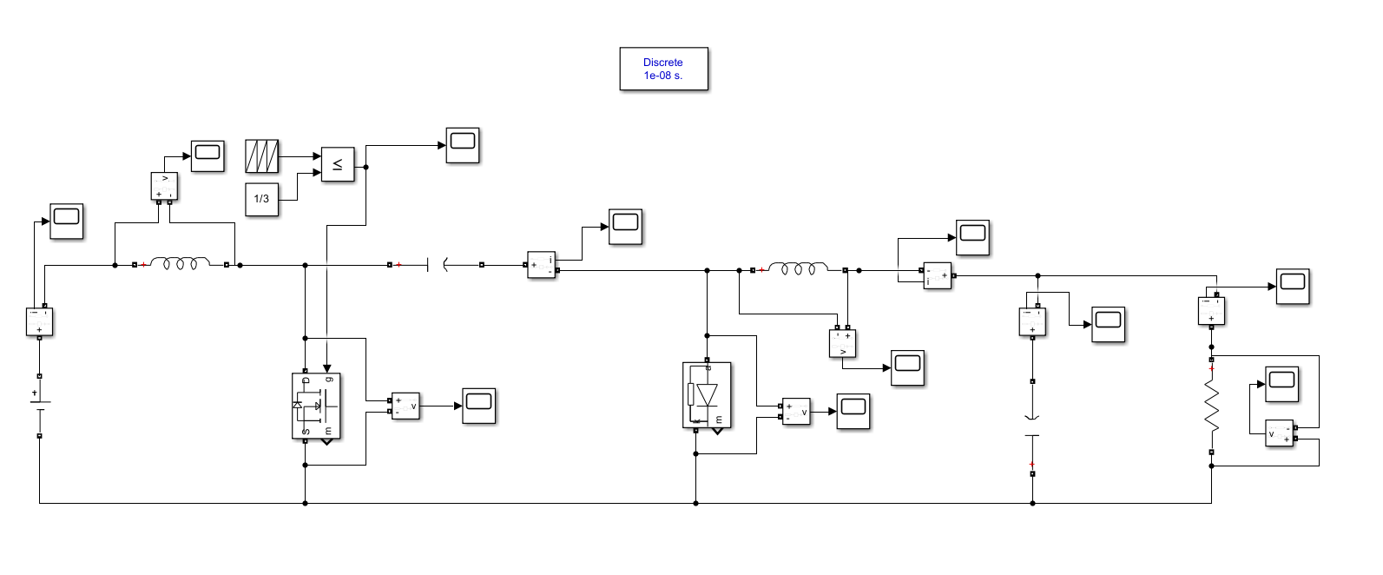
SIMULINK model

Slide 13
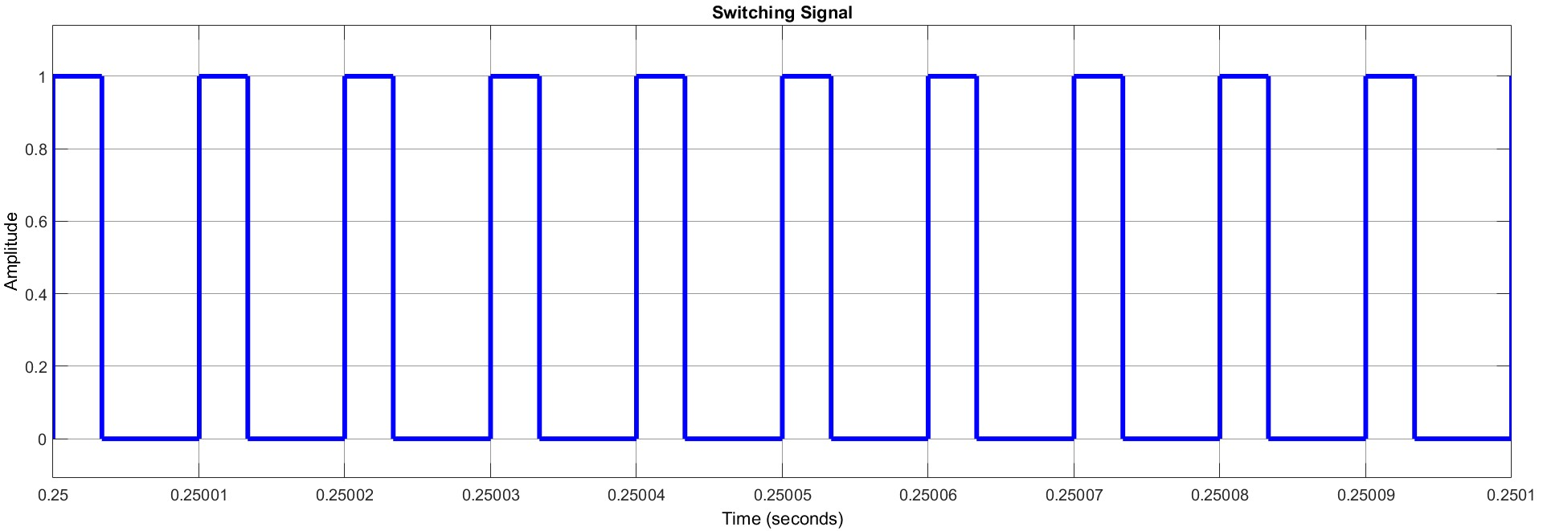
Simulation Waveforms

Slide 14
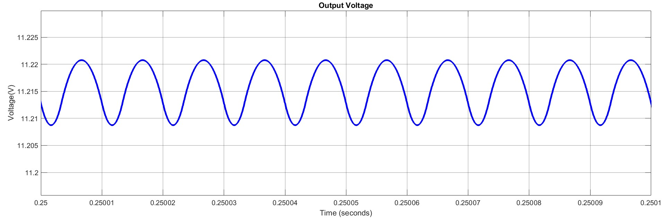
Simulation Waveforms

Slide 15
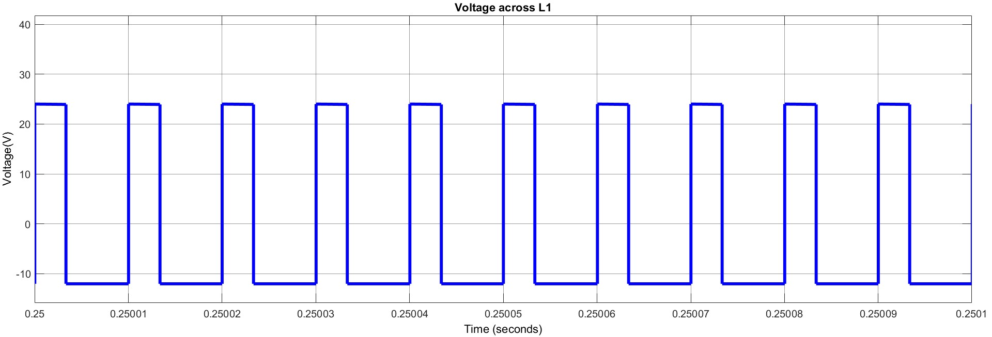
Simulation Waveforms

Slide 16
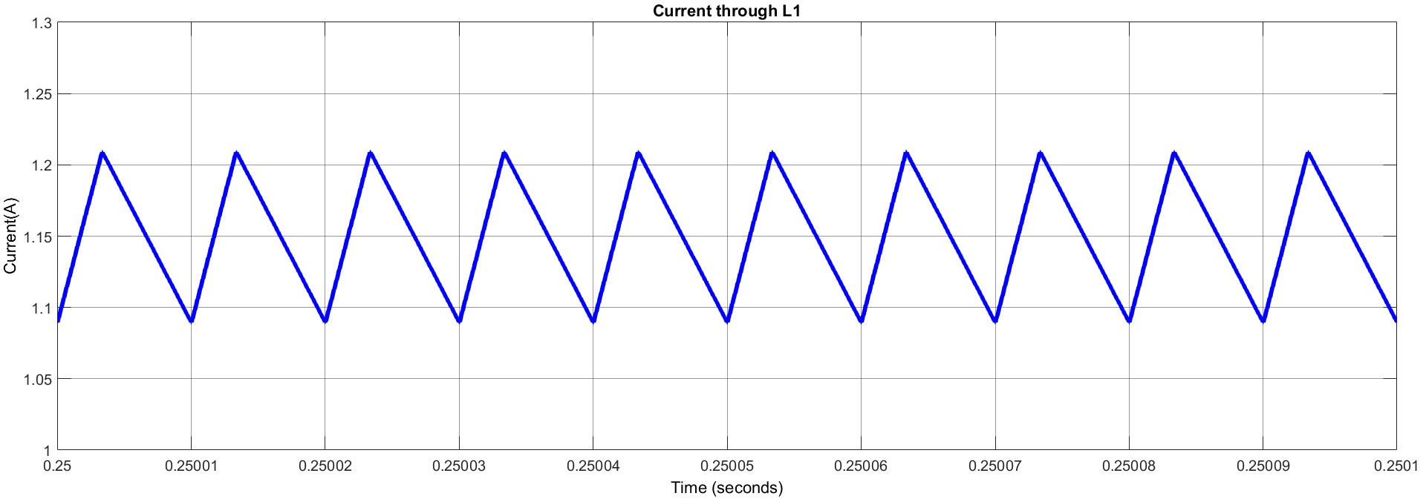
Simulation Waveforms

Slide 17

Simulation Waveforms

Slide 18
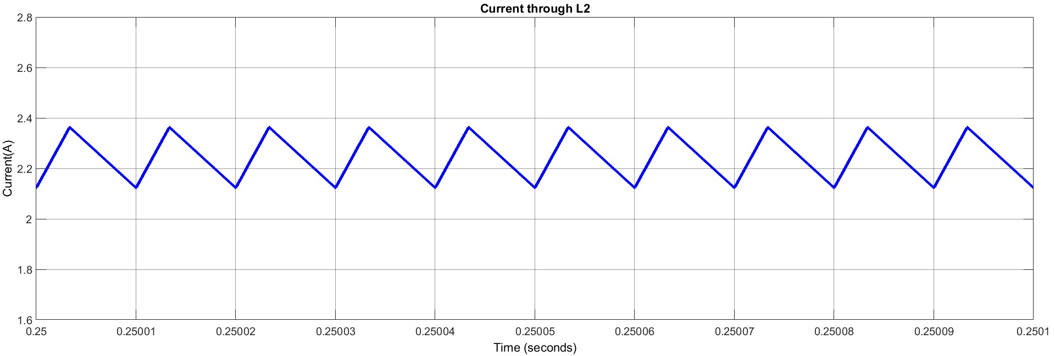
Simulation Waveforms

Slide 19
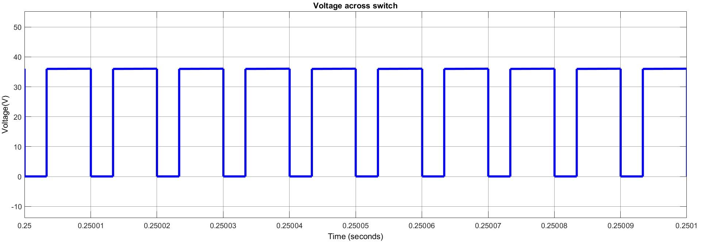
Simulation Waveforms

Slide 20
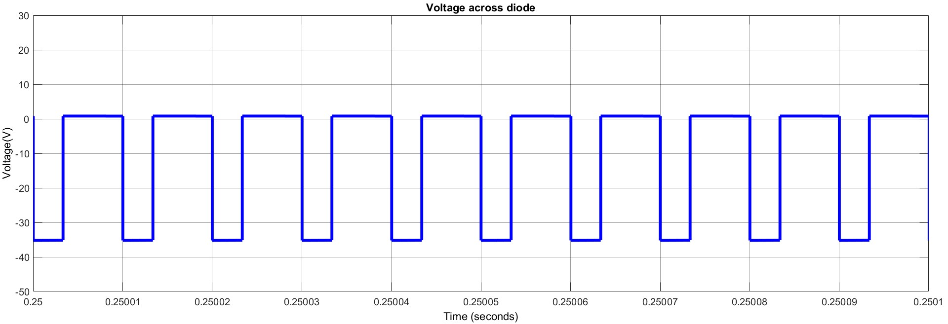
Simulation Waveforms

Slide 21
Observation
Parameter | Theoritical Value | Practical Value
V_{o} | 12 V | 11.22 V
ΔV_{o} | 0.012 V | 0.01202 V
I_{L1} | 1.2 A | 1.149 A
Δi_{L1} | 0.12 A | 0.1197 A
I_{L2} | 2.4 A | 2.243 A
Δi_{L2} | 0.24 A | 0.2399 A

Slide 22
Closed Loop Control of CUK Converter
One way to get the output voltage as required is to employ closed loop control by using PI controller. Using PI controller has many advantages like faster settling and decrease of steady state error.

Slide 23
Circuit Diagram

Slide 24
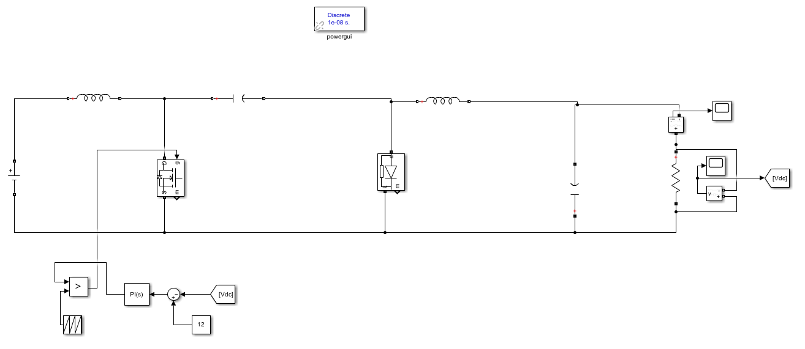
SIMULINK model

Slide 25
PI Controller gain values
Parameter | Value
Proportional Gain | 9
Integral Gain | 527

Slide 26
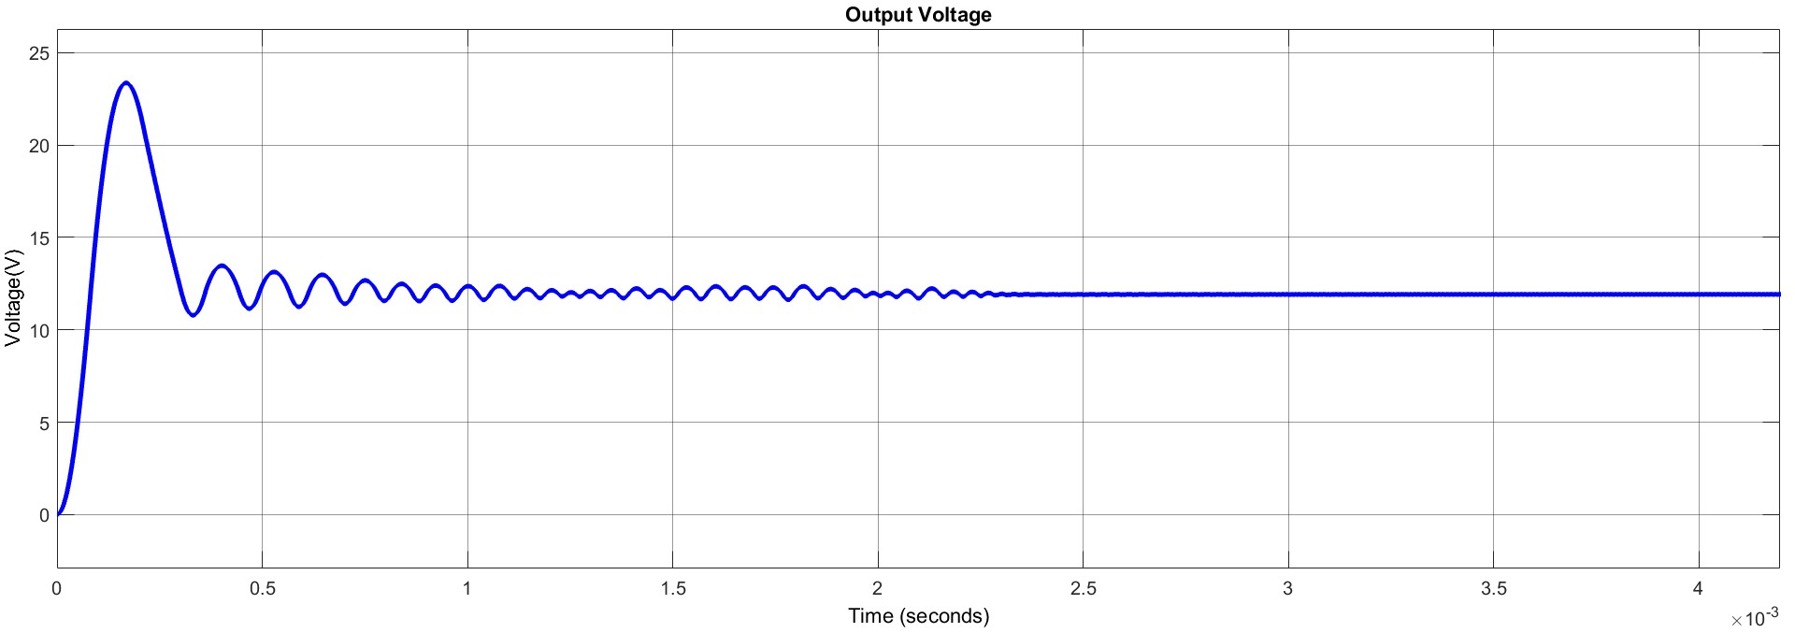
Output Voltage Waveform

Slide 27
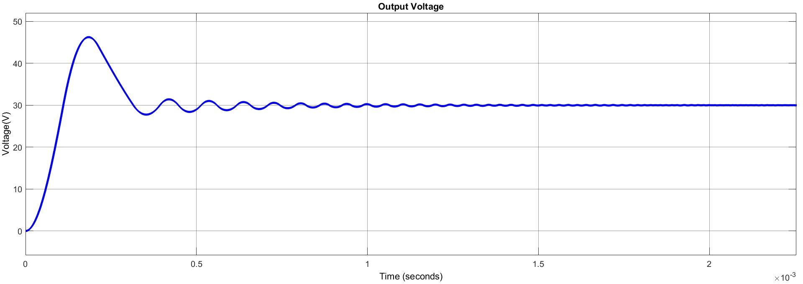
Output Voltage Waveform

Slide 28
Application in Solar energy
Maximum Power Point Tracking Systems.
Grid connected PV systems with inversion requirement.
Hybrid Renewable Energy Systems.
Electric Vehicle Solar Chargers.

Slide 29
References
[1] N. Mohan, T. M. Undeland, and W. P. Robbins, Power electronics: converters, applications, and design. John wiley & sons, 2003.
[2] M. Syam and T. S. Kailas, “Grid connected pv system using cuk converter,” in 2013 Annual Interna-tional Conference on Emerging Research Areas and 2013 International Conference on Microelectron-ics, Communications and Renewable Energy. IEEE, 2013, pp. 1–6.
[3] R. Dwivedi, V. K. Dwivedi, and R. Sharma, “Parametric variation analysis of cuk converter forconstant voltage applications,” International Journal of Advanced Research in Electrical, Electronicsand Instrumentation Engineering, vol. 3, no. 2, pp. 7108–7117, 2014.

Slide 30
Thank you

